Slide 1
Network Security – 3413ICT
Mini Test # 01 Time: 15 min.
Please write your Name & Student Number
… Any dishonest assignments will be dealt with under the rules applying in “The Process of Assessment, Grading and Dissemination of Results” and Statute 8.2 - Student Good Order as defined in the University Handbook.
Dishonest assignment includes:
• deliberate copying or attempting to copy the work of other students;
• use of or attempting to use information prohibited from use in that form of assessment;
• submitting the work or another as your own; or
• plagiarism (i.e. taking and using as your own the thoughts and writings of another with the intent to claim the work as your own).

Slide 2
3413ICT Network Security
Lecture 4A: Web Security
Dr V. Muthukkumarasamy
B.Sc.Eng (Hons) (Peradeniya), PhD (Cantab), MIEE, MIEEE
Notes:
Griffith University, School of ICT
2010/1
3400ICT Information System Security
2
Griffith University, School of ICT
2010/1
3400ICT Information System Security
2

Slide 3
Previous Lecture..
We have studied
Kerberos trusted key server system
X.509 authentication and certificates
IPSec security framework
AH, ESP
Key management

Slide 4
Today’s Objectives
To understand the need for the Web security
To study the security protocol, Secure Socket Layer (SSL), and briefly, Transport Layer Security (TLS)
To explain the SET, a secure payment protocol

Slide 5
References
Cryptography and Network Security: Principles and Practice, 6th ed.,
William Stallings, Chapter 17

Slide 6
Web Security
Web is widely used by businesses, government, and individuals
But Internet & Web are vulnerable
There exist a variety of threats on
Integrity
Confidentiality
Authentication
Service Availability (i.e., denial of service)
Need added security mechanisms

Slide 7
Web Security Threats
Threats may be classified as:
Passive attacks
Eavesdropping
Active attacks
Impersonating
Altering messages in transit or on a website
Threats can be on:
Web server
Web browser
Network traffic

Slide 8
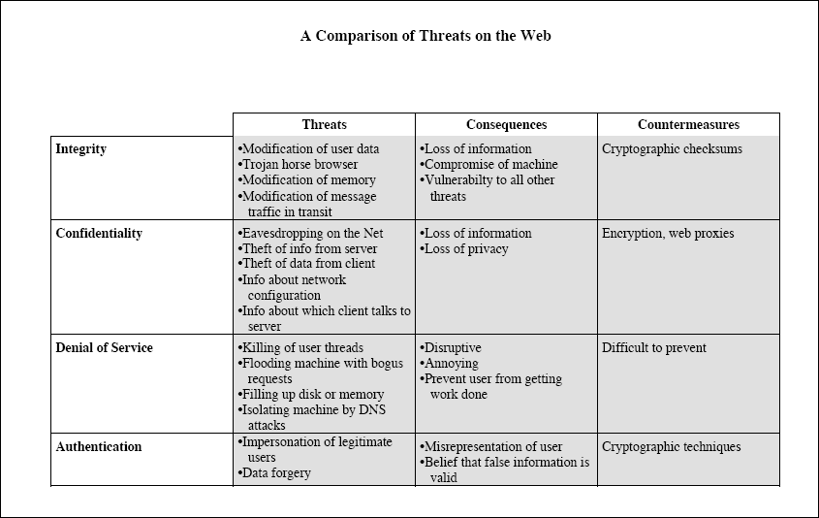
Notes:
Exam question

Slide 9
Solutions to Web Security
We will study two standardized schemes:
SSL (Secure Sockets Layer) and briefly TLS (Transport Layer Security)
SET (Secure Electronic Transaction)
3D-Secure

Slide 10
SSL and TLS
Secure socket layer (SSL) is a transport layer security service
SSL was originally developed by Netscape
It subsequently became Internet standard known as TLS (Transport Layer Security)
SSL/TLS provides(exam question)
Confidentiality – using symmetric encryption
Message integrity – using message authentication code
Notes:
SSL probably most widely used Web security mechanism, and it is implemented at the Transport layer (cf. figure 16.1b on previous slide).
SSL is designed to make use of TCP to provide a reliable end-to-end secure service. Netscape originated SSL. Version 3 of the protocol was designed with public review and input from industry and was published as an Internet draft document. Subsequently, when a consensus was reached to submit the protocol for Internet standardization, the TLS working group was formed within IETF to develop a common standard. This first published version of TLS can be viewed as essentially an SSLv3.1 and is very close to and backward compatible with SSLv3. SSL is not a single protocol but rather two layers of protocol, as shown next.

Slide 11
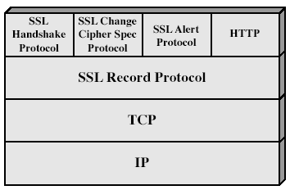
SSL Architecture
SSL is not a single protocol, but rather two layers of protocols
Notes:
Stallings Fig 17-2.

Slide 12
SSL Protocols
Record Protocol (of SSL) provides basic security services to various higher layer protocols (e.g., HTTP)
The other 3 SSL-specific protocols are used in the management of SSL exchanges
Handshake protocol
Change cipher spec protocol
Alert protocol
Two important SSL concepts are:
SSL session
SSL connection

Slide 13
SSL Session & SSL Connection
SSL session
An association between client & server
It is created by the Handshake Protocol
Defines a set of cryptographic parameters
May be shared by multiple SSL connections
SSL connection
A transient, peer-to-peer, communications link
It is associated with one SSL session

Slide 14
SSL Record Protocol
SSL Record Protocol Provides two services:
Confidentiality
Using symmetric encryption with a shared secret key defined by Handshake Protocol
IDEA, DES, 3DES, AES, RC2-40, RC4-40, RC4-128, etc
Message is compressed before encryption
Message integrity
Using a MAC with shared secret key
Notes:
SSL Record Protocol defines these two services for SSL connections.

Slide 15
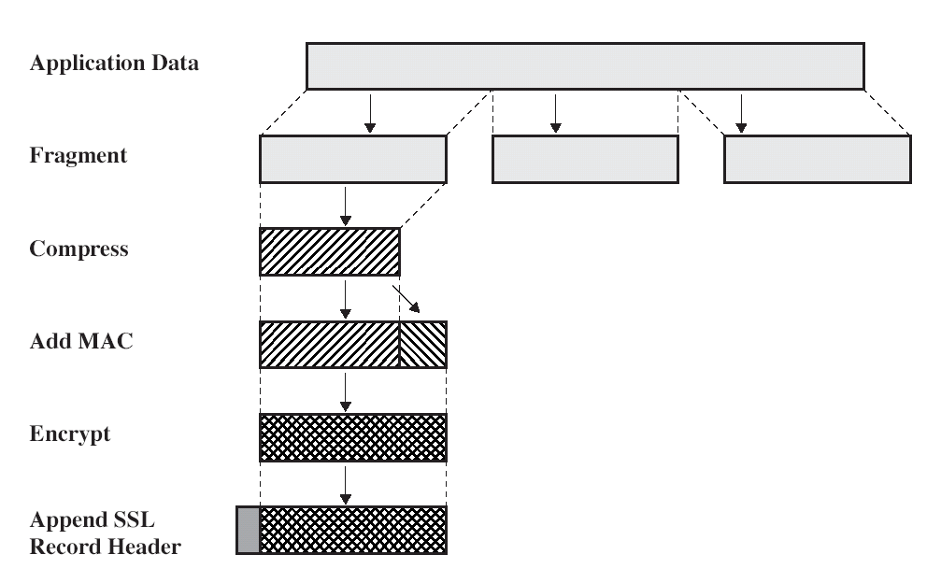
SSL Record Protocol Operation

Slide 16
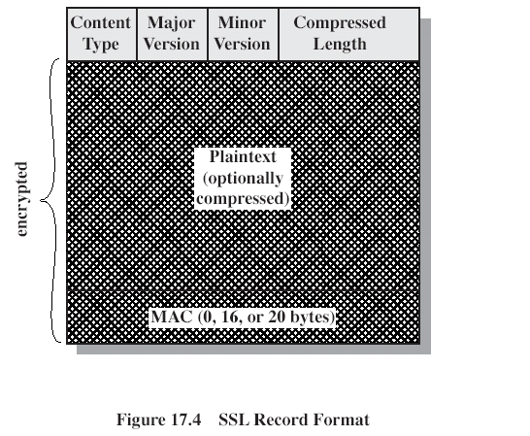

Slide 17
SSL Handshake Protocol
Handshake protocol allows server & client to:
authenticate each other
negotiate encryption & MAC algorithms
negotiate cryptographic keys
It comprises a series of messages in phases
Phase 1: Establish security capabilities
Phase 2: Server authentication and key exchange
Phase 3: Client authentication and key exchange
Phase 4: Finish

Slide 18
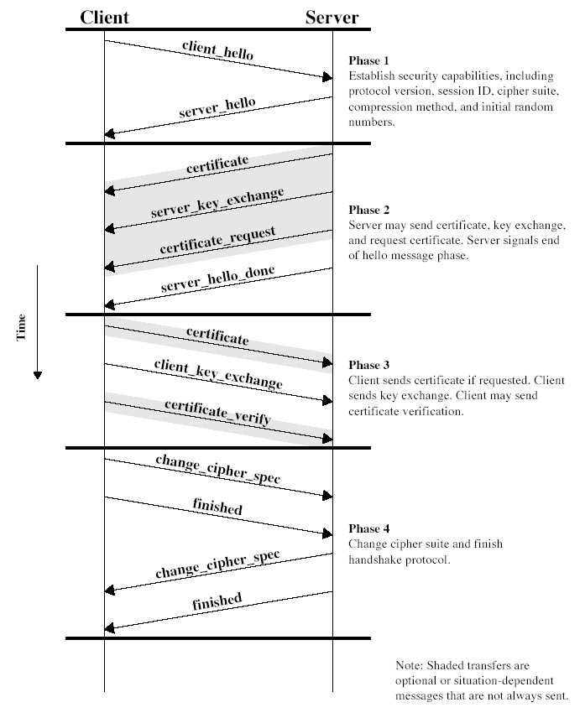
SSL Handshake Protocol
Notes:
Stallings Fig 17-6.

Slide 19
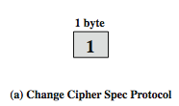
SSL Change Cipher Spec Protocol
Change Cipher Spec Protocol consists of a single message
which consists of a single byte
The sole purpose of this message is to cause the pending state to become the current state
hence updating the cipher suite in use

Slide 20
SSL Alert Protocol
It is used to convey SSL-related alerts to peer entity
Each message in this protocol consists of two bytes
The first byte takes the value: warning or fatal
If the level is fatal, SSL immediately terminates the connection
The 2nd byte contains a code indicating a specific alert
Fatal alerts: unexpected message, bad record MAC, decompression failure, handshake failure, illegal parameter
Other alerts: close notify, no certificate, bad certificate, unsupported certificate, certificate revoked, certificate expired, certificate unknown, etc

Slide 21
TLS (Transport Layer Security)
TLS is an IETF (Internet Engineering Task Force) standardization initiative – goal is to produce an Internet standard version of SSL
TLS has minor differences with SSLv3 in the following aspects:
Version number
MAC
Pseudo-random function
Alert codes
Cipher suites and cryptographic computations
Certificate types and verification, etc

Slide 22
Secure Electronic Transaction (SET)
SET is an open encryption and security specification
to protect Internet credit card transactions
It was developed in 1996 by Mastercard and Visa
Companies who were involved in developing SET: IBM, Microsoft, Netscape, RSA, Terisa, & Verisign
It is not a payment system, rather a set of security protocols & formats

Slide 23
Security Services by SET
SET provides security services which enable users to use the existing credit card payment infrastructure on an open network
Services include:
Secure communications channel among all parties in a transaction
Trust by the use of X.509v3 digital certificates
Privacy – information is only available to those who need it

Slide 24
SET Key Features
Confidentiality of information – Cardholder's account and payment information are secured as they travel on the network
An interesting feature of SET is that it prevents the merchant from learning the credit card number
Integrity of data – SHA-1 and RSA are used for digital signature
Credit card account authentication – Merchants can verify that a cardholder is a legitimate user and the card is valid
Merchant authentication – Cardholder can verify that a merchant has a relationship with the financial institution, using X.509 certificate and RSA signature

Slide 25
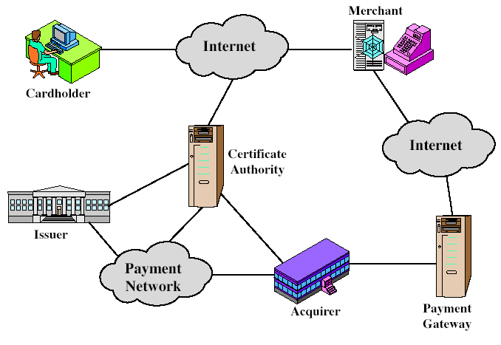
SET Participants
Notes:
Stallings Fig 17-8.

Slide 26
Purchase/Payment Transaction
Customer opens account and receives a certificate
Merchants have their own certificates
Customer places an order
Merchant is verified
Payment request is sent
Merchant requests payment authorization
Merchant confirms order
Merchant provides goods or service
Merchant receives payment

Slide 27
Dual Signature
SET provides a unique security solution, which is called dual signature
Dual signature includes two messages
One for the acquirer – based on the payment information (PI); but does not show purchase/product information
Another for the merchant – based on the order information (OI); but does not contain the account detail
Not only provides data confidentiality and authentication, but also protects the privacy of the customer

Slide 28
Dual Signature Generation
The customer, say C, generates message digests of the order information (OIMD) and the payment information (PIMD)
OIMD = H(OI)
PIMD = H(PI)
where H is based on SHA-1 algorithm
Two MDs are concatenated, H(PI) || H(OI); and then the hash of the result is taken, that is,
H ( H(PI) || H(OI) )
C using his/her private key, KRc, creates the dual signature as:
DS = E(KRc, H(H(PI) || H(OI)))

Slide 29
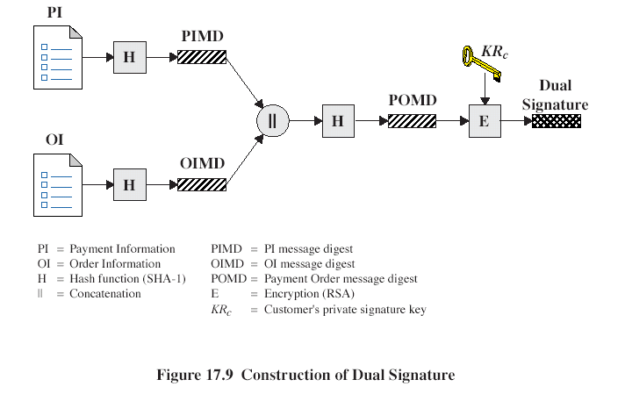

Slide 30
Signature Verification by Merchant
Merchant has: OI, PIMD, dual signature DS, and Public key of C, namely KUc
Note: Given PIMD=H(PI), the merchant doesn’t know PI detail
Merchant generates H(OI), and then PIMD || H(OI)
Merchant then generates H( PIMD || H(OI))
Merchant decrypts DS, that is, computes
D(KUc, DS)
Merchant compares the following two values. If they are equal, the signature is valid
H(PIMD || H(OI)) and D(KUc, DS)

Slide 31
Signature Verification by Bank
Bank has: PI, OIMD, dual signature DS, and Public key of C, namely KUc
Note: Given OIMD=H(OI), the bank doesn’t know OI detail
Bank computes H(PI), and then H(PI) || OIMD
Bank then computes H( H(PI) || OIMD)
Bank decrypts DS, that is, computes
D(KUc, DS)
Bank compares the following two values. If they are equal, the signature is valid
H(H(PI) || OIMD) and D(KUc, DS)

Slide 32
Payment Processing
SET supports a number of transactions for a secure payment, including:
Purchase request
Payment authorization
Payment capture

Slide 33
Purchase Request
Before the purchase-request exchange begins, customer and merchant will exchange certificates
Customer then generates a one-time symmetric key, Ks, for encryption and decryption
Purchase request includes the following:
Purchase-related information – This will be received by the merchant (in ciphertext), and forwarded to the payment gateway (by the merchant)
Order-related information – This is received and needed by the merchant
Customer’s public key for verifying the signature

Slide 34
Purchase-related Information
Merchant receives the purchase-related information (in ciphertext), and forwards to the payment gateway:
The PI
Dual signature, DS = E(KRc, H(H(PI) || H(OI))
OI message digest OIMD = H(OI)
All these items are encrypted by using Ks
Also, it include a digital envelope, which is formed by encrypting Ks, with the payment gateway’s public key
– Note: Merchant cannot read Ks, and cannot read PI

Slide 35
Order-related Information
The following information will be used by the merchant to verify the dual signature
The OI
Dual signature, DS = E(KRc, H(H(PI) || H(OI))
PI message digest PIMD
Customer’s certificate including the public key

Slide 36
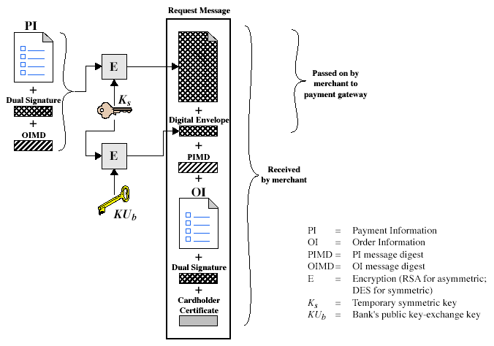
Purchase Request by Customer
Notes:
Stallings Fig 17-10.

Slide 37
Processing Purchase Request by Merchant
Verifies cardholder certificates
Verifies dual signature using customer's public key, to ensure order has not been tampered with in transit & that it was signed using cardholder's private key
Processes the order, and forwards the payment information to the payment gateway for authorization
Sends a purchase response to cardholder

Slide 38
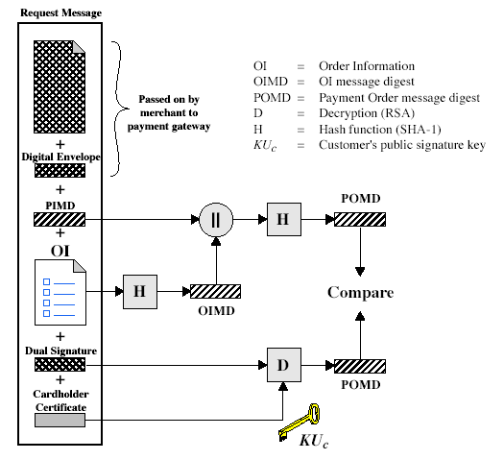
Processing Purchase Request by Merchant
Notes:
Stallings Fig 17-11.

Slide 39
Payment Authorization
The merchant sends an authorization request to the payment gateway, consisting of
Purchase-related information, which was received from the customer
Authorization-related information:
An authorization block, including the transaction ID, signed with the merchant’s private key, and encrypted with a one-time key
A digital envelope, including the one-time key, encrypted by the gateway’s public key
Merchant’s certificate

Slide 40
Payment Gateway Authorization
Verifies all certificates
Decrypts digital envelope of authorization block to obtain symmetric key & then decrypts authorization block
Verifies merchant's signature on authorization block
Decrypts digital envelope for the purchase-related information to obtain symmetric key, decrypts purchase-related information
Verifies dual signature by the customer
Verifies that transaction ID received from merchant matches that in PI received (indirectly) from customer
Requests & receives an authorization from the card issuer
Sends authorization response back to merchant

Slide 41
Payment Capture
Merchant sends payment gateway a payment capture request
Gateway checks the request
Then causes funds to be transferred to the account of the merchant
Gateway notifies the merchant of a payment using a capture response

Slide 42
3-D Secure
SET got ‘Engineering’ right, but ‘Economics’ wrong
3-D Secure got ‘Economics’ right, but ‘Engineering wrong
Branded as “Verified by Visa” and “MasterCard SecureCode”
It allows you to use a password with your credit card to pay at many merchant websites
Similar to Passport, OpenID etc, it redirects you to a central login service
It was the card industry’s solution to a big rise in card-not-present (CNP) fraud

Slide 43
Summary
We have considered:
Web security issues
SSL/TLS security protocols
SET secure credit card payment protocols

Slide 44
Next Lecture
Intruders…

Slide 45

Questions?
45

